Slide 1
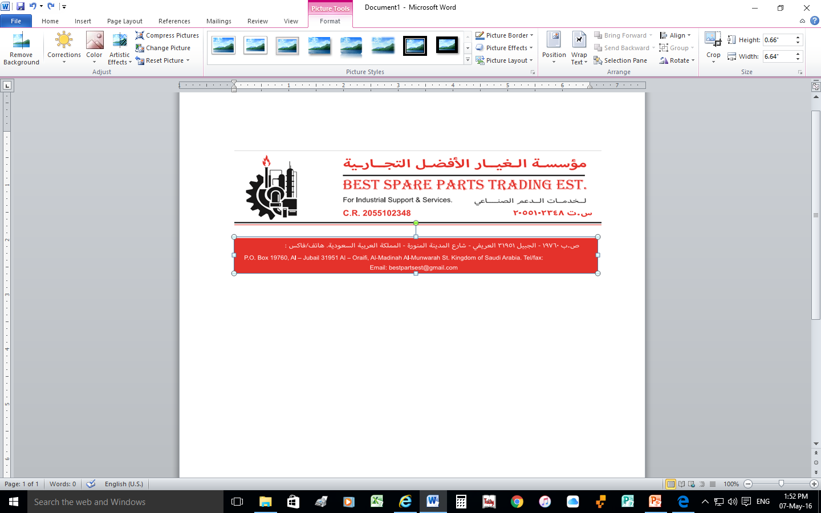
COMPANY PROFILE
SAUDI ARAMCO VENDOR ID # 0010059457
SAUDI ELECTRICITY VENDOR ID # VD017380
BEST SPARE PARTS
GENERAL TRADING EST
FOR INDUSTRIAL SUPPORT, SERVICES, MATERIAL, & SPARE PARTS

Slide 2
BEST SPARE PARTS IS RENDERED
FOR SUPPLY OF
INDUSTRIAL MATERIALS &
SPARE PARTS

Slide 3
CONTENTS
Introduction
About US
Vision & Mission
Office Location
Organizational Information
Organization Chart
Commercial Registration Certificate
Chamber of Commerce Certificate
Zakat Certificate 1/2
Zakat Certificate 2/2
Gozi Certificate
Service Details
Product Catalog
Contact Details

Slide 4
INTRODUCTION
We take this pleasure to introduce our self as “Best Spare Parts Trading Est." We are in the business from past 8 years & one of the leading suppliers of wide spectrum of Industrial Material. Our traded Industrial Material find wide application in various Industries such as Automotive, Paper, Steel, Petrochemical and several other industries.
We are confident that the fine Quality and Reasonable Prices will bring you high economic benefits and we sincerely believe to develop healthy relation & good contacts with your esteemed company & are waiting passionately to receive quarries to give reliable, prompt & quality services at most competitive prices.
Kindly register our Name in the approved list of your Supplying Vendors. so we can have your Enquires on regular basis to submit Quotations as and when required.

Slide 5
Best Spare Parts Trading Est, is widely regarded as the most interesting and valuable sources of getting all kind of spares with respect to the proper brands and part numbers
Furthermore, we use the sophisticated computer programs to locate the material with code and part number, we do keep all the records of manufacturer and agents world wide, it help us to locate any material in easy manner. If, for any parts need to expose thro comprehensive details and drawing, we are giving our valuable customer to have a complete evaluation technically to proceed us in a respective manner according to our customer requirement

Slide 6
ABOUT US
The Management of “Best Spare Parts Trading Est.” is firmly committed to quality.
We know that the future of the company depends on the satisfaction of our customer, and convinced that the satisfaction of our customer depends on the excellence of our products and services. It is therefore our highest priority to ensure that all aspects of quality control are addressed throughout our organization and in all our strategic planning.
We believe that each individual member who performs an activity or task in producing a product or service delivers a unique contribution to quality of that product or service. It is therefore management policy that these individual members are held responsible and accountable for those quality aspects, which form part of their particular activities or task. The company will ensure that each member contributes significant to high quality standards, and all employees have an understanding of the company objectives and goals.

Slide 7
VISION
To be the first choice provider of Industrial Material Suppliers & Services, and other related services.
Through service excellence, we ensure that our clients will prefer our services than our competitors.
MISSION
To apply our knowledge and skills to develop, new techniques to meet our customer requirements.
We prefer to prosper on the basis of professionalism and performance. We bring to the table excellent skills in all areas of our operations. We are a team oriented company thus ensuring that our decision making criteria are always in the best interest of our clients, staff and off course all stakeholders.

Slide 8
LOCATION
Best Spare Parts OFFICE Located in AL-JUBAIL – KING FAHAD BIN ABDULAZIZ ROAD (Jeddah Street). Kingdom of SAUDI ARABIA and address as mentioned here under :
P. O. BOX 19760 AL – JUBAIL 31951
JEDDAH STREET
KINGDOM OF SAUDI ARABIA
Tel / Fax: 013 625 5220
MOBILE. : +966 536408626
EMAIL: : info@bsp.com.sa / younus@bsp.com.sa / ali@bsp.com.sa

Slide 9
ORGANIZATIONAL INFORMATION
Date of Company Founded : 2012
Type of Company : BEST SPARE PARTS TRADING EST
Name of Owner : SAEED BIN ABDULLAH AL - MARHOON
Registered under the laws of : SAUDI ARABIA
Commercial Registration No. : 2055102348
Total No. of Employees : 07
BANK REFERENCES
BEST SPARE PARTS TRADING EST.
ACCOUNT NO. : 830063939001
IBAN NO. : SA36 4500 0000 8300 6393 9001
CURRENCY : SAR
BRANCH : JUBAIL CITY (126)
BANK : SAUDI AWWAL BANK (SAB)

Slide 10
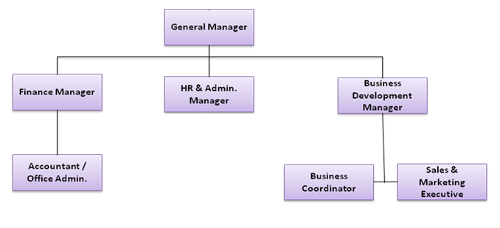
ORGANAZATION CHART

Slide 11
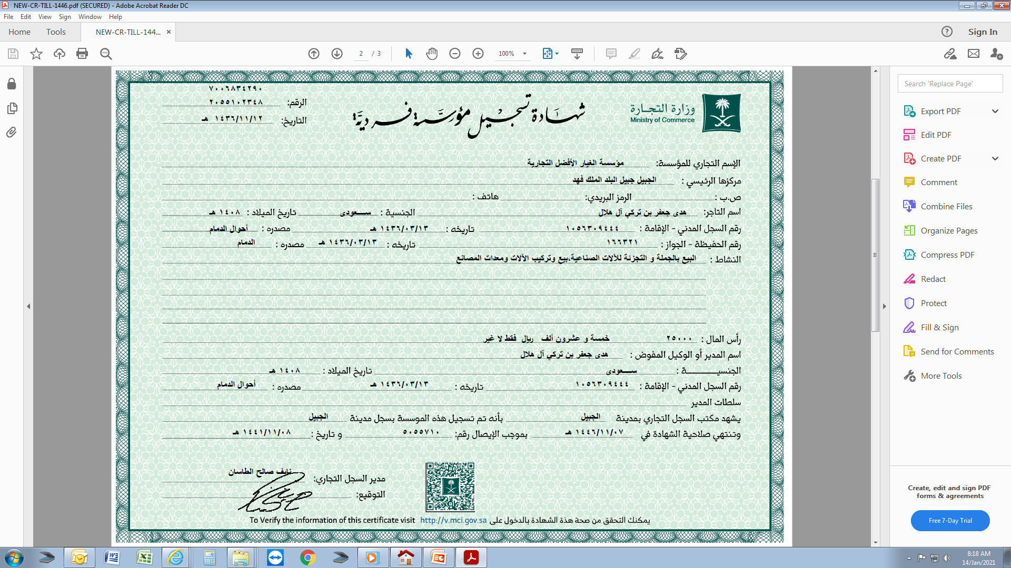
COMERCIAL REGISTRATION

Slide 12
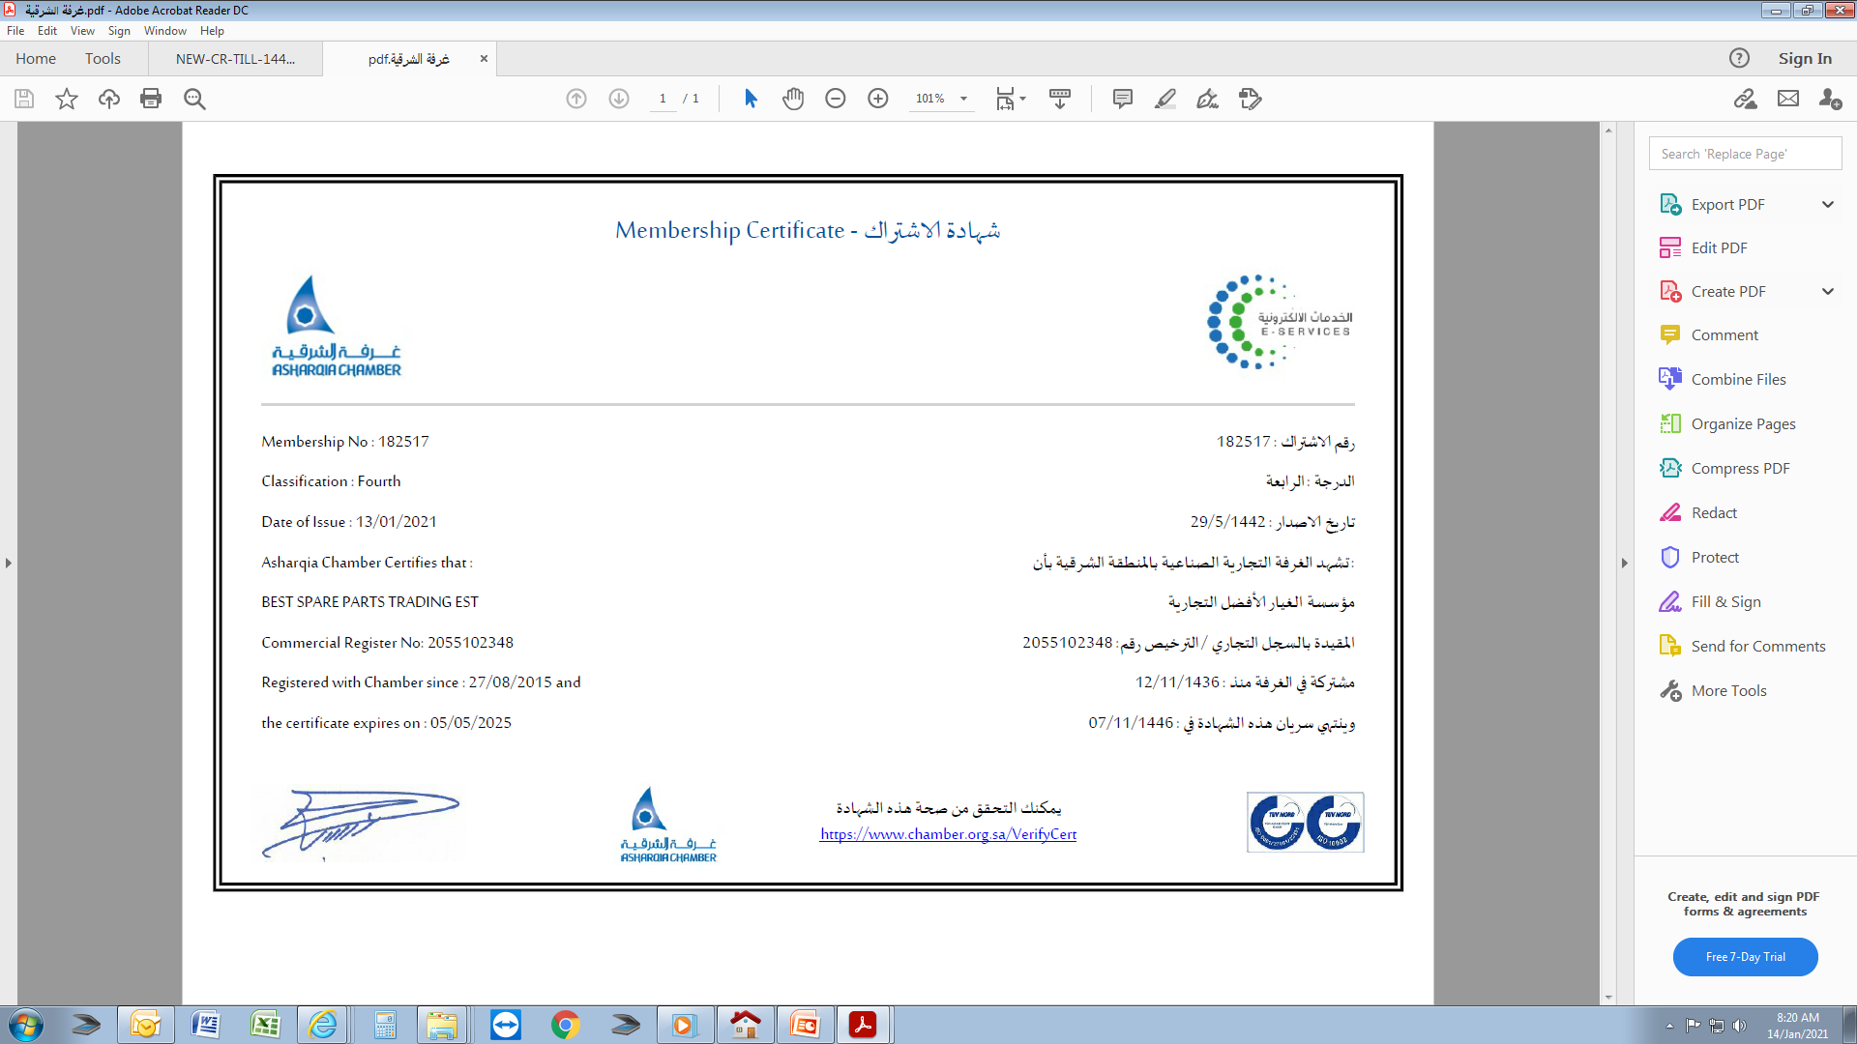
CHAMBER OF COMERCE

Slide 13

ZAKAT CERTIFICATE 1/2

Slide 14
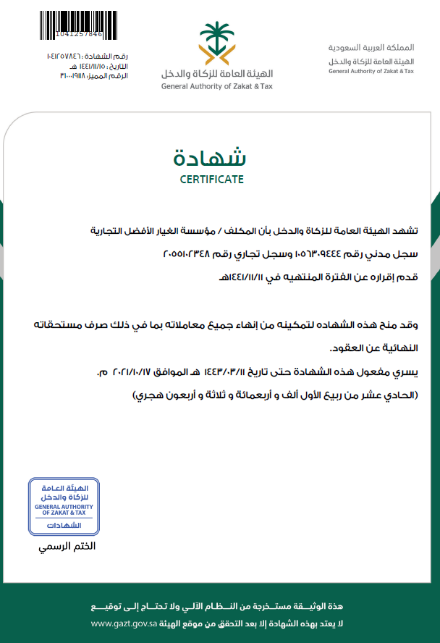
ZAKAT CERTIFICATE 2/2

Slide 15
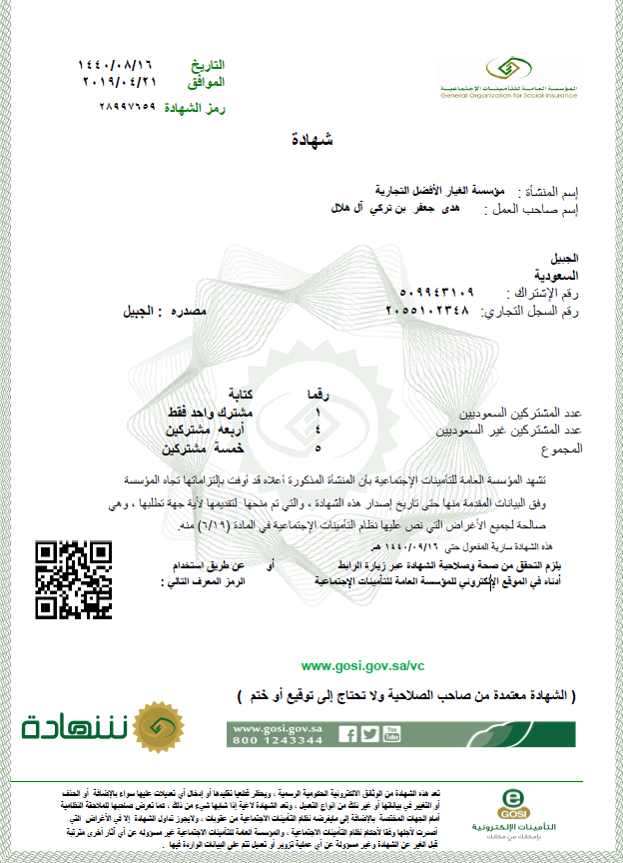
GOSI CERTIFICATE

Slide 16
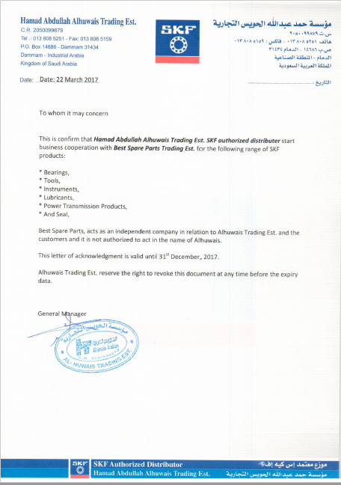
SKF – Sub Distributor
Authorization
Hamad Abdullah Alhuwais Trading Est.

Slide 17
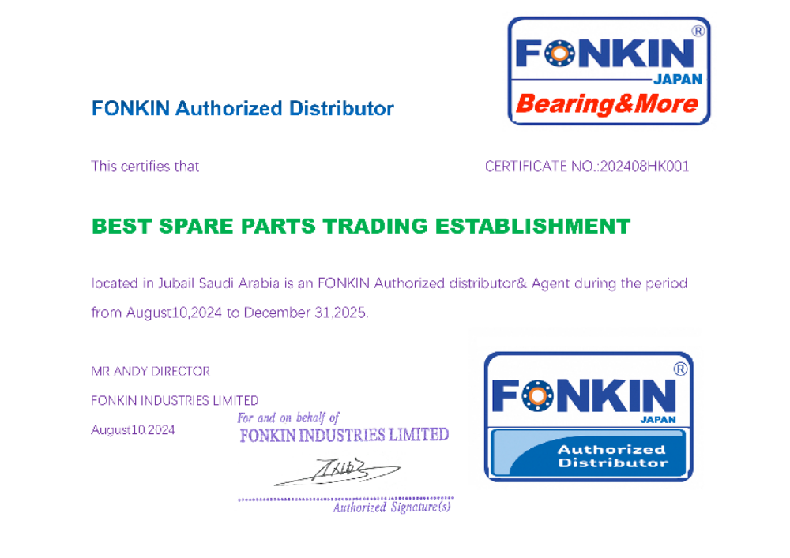
FONKIN – Distributor
Authorization
FONKIN INDUSTRIES LIMITED.

Slide 18
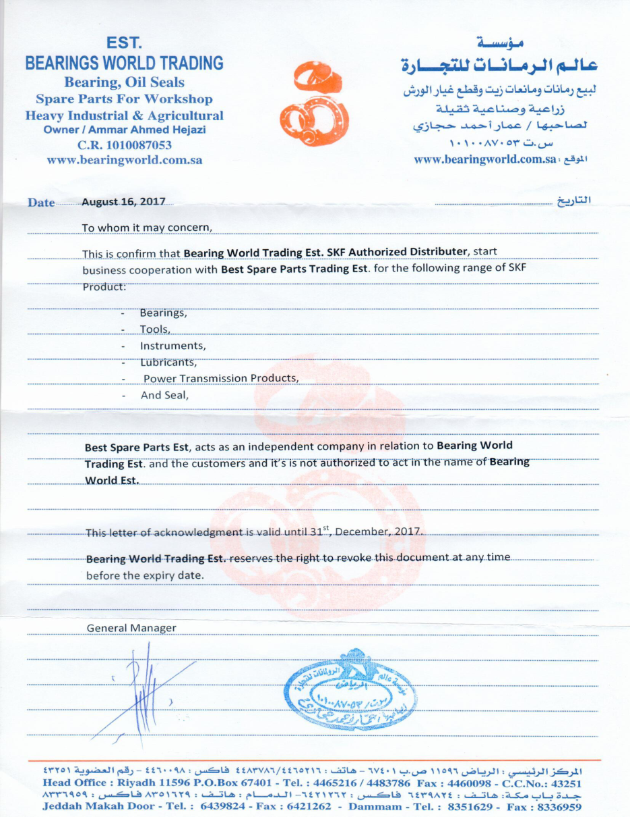
SKF – Sub Distributor
Authorization
Bearings World Trading

Slide 19
WE PROVIDE THE FOLLOWING SERVICES
All Types of Bearings, Mechanical Seals, O Ring Cords, Belts (Main Product of BSPTE). All Types of Grating / Spectacle Blinds / Spades / Spacers. All Types of Instrumentation Fittings. All Types of Structural Steel. All Types of Flanges. All Types of Valves. All Types of Gaskets & Flanges Insulation Kits. All Types of Bolts & Nuts – Gauges. All Kind Industrial Material. All Types of Weld Fittings. All Types of Pipes, Instrumentation Fittings. All Types of Tubes & Pipes. Safety Equipments, Pre-Commissioning Tools. Heavy Equipments for Rent. Supply of Photocopying Machines & Printer MFP’s. Computers, IT Peripherals.

Slide 20








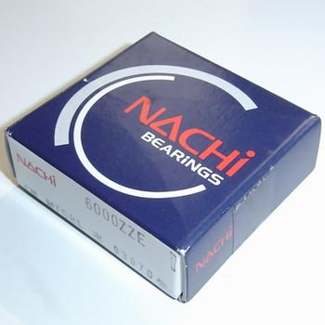

PRODUCT CATALOG
All Brand of Bearings

Slide 21
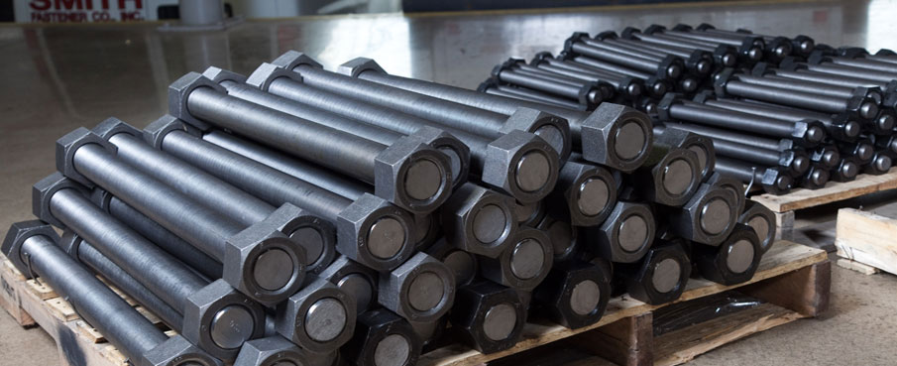
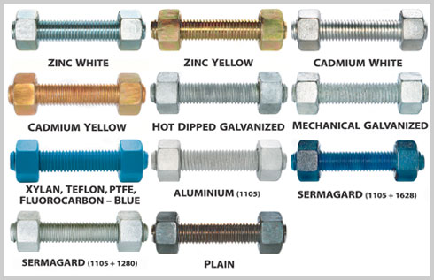
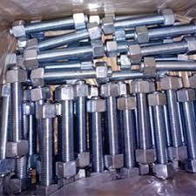
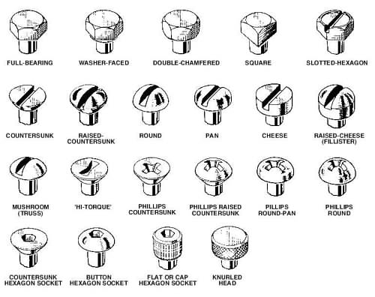
PRODUCT CATALOG
All Kind & Grades of Stud Bolts, Fastners

Slide 22
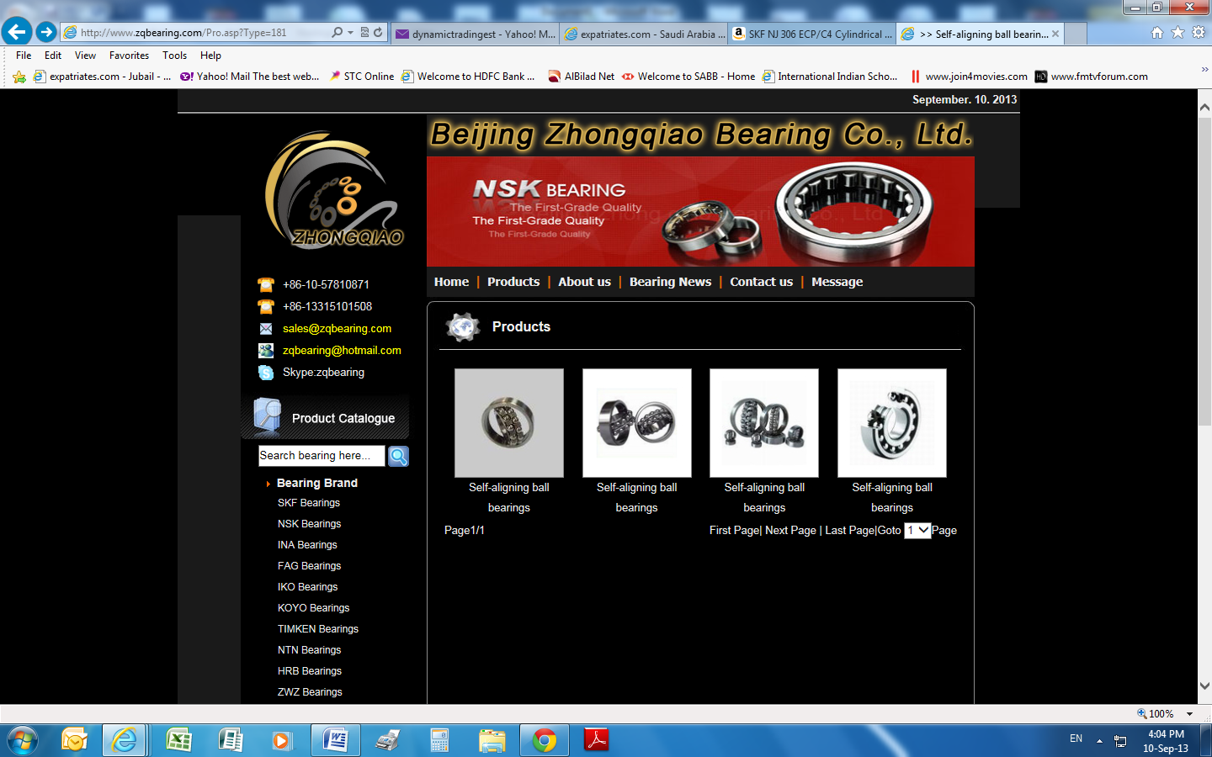
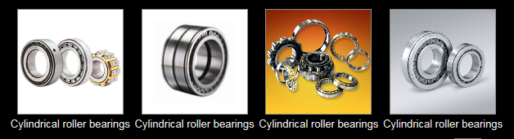
All Types of Bearing

Slide 23
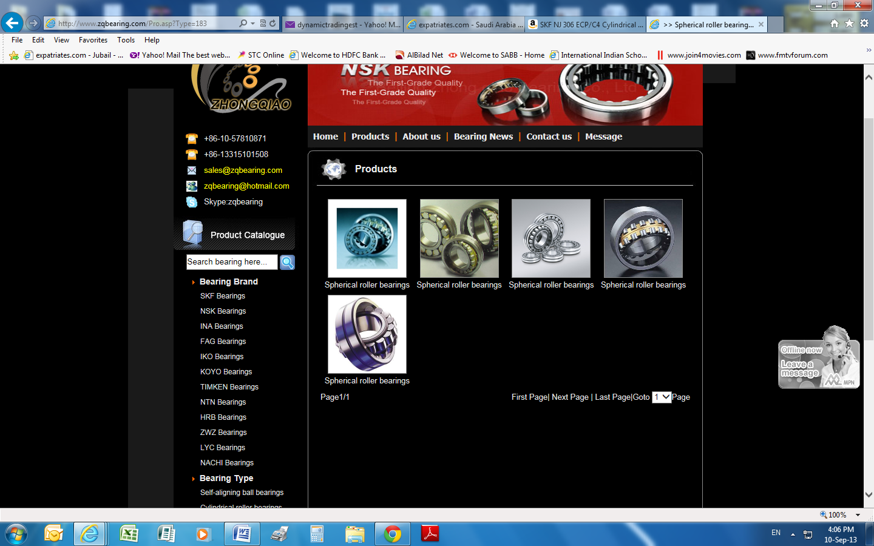
All Types of Bearing

Slide 24
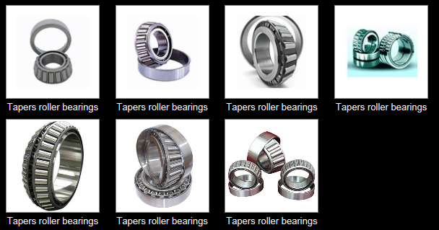
All Types of Bearing

Slide 25
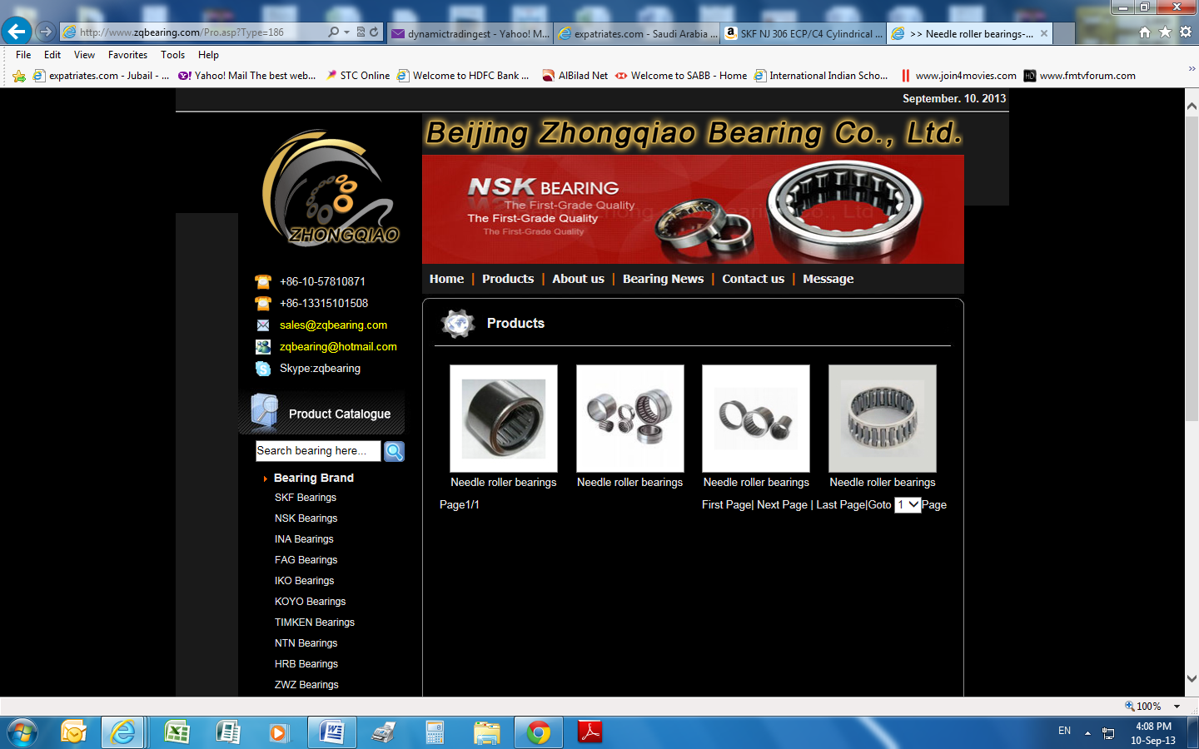
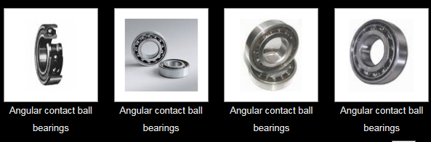
All Types of Bearing

Slide 26
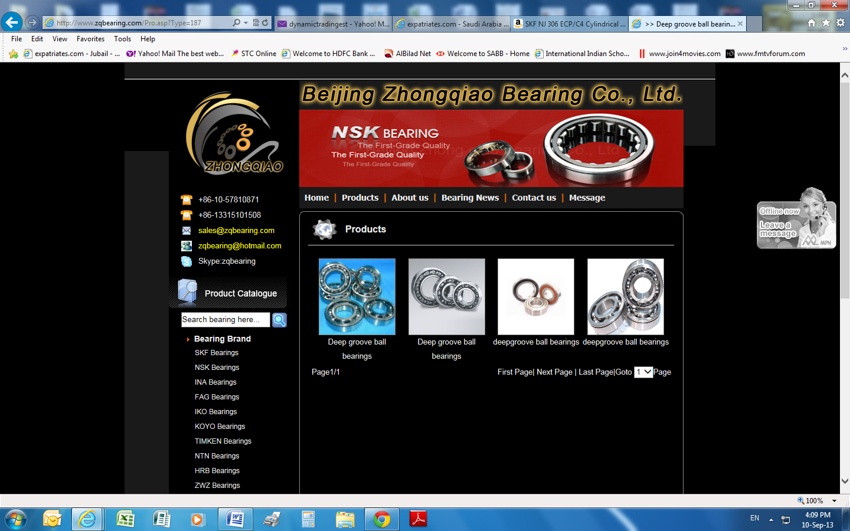
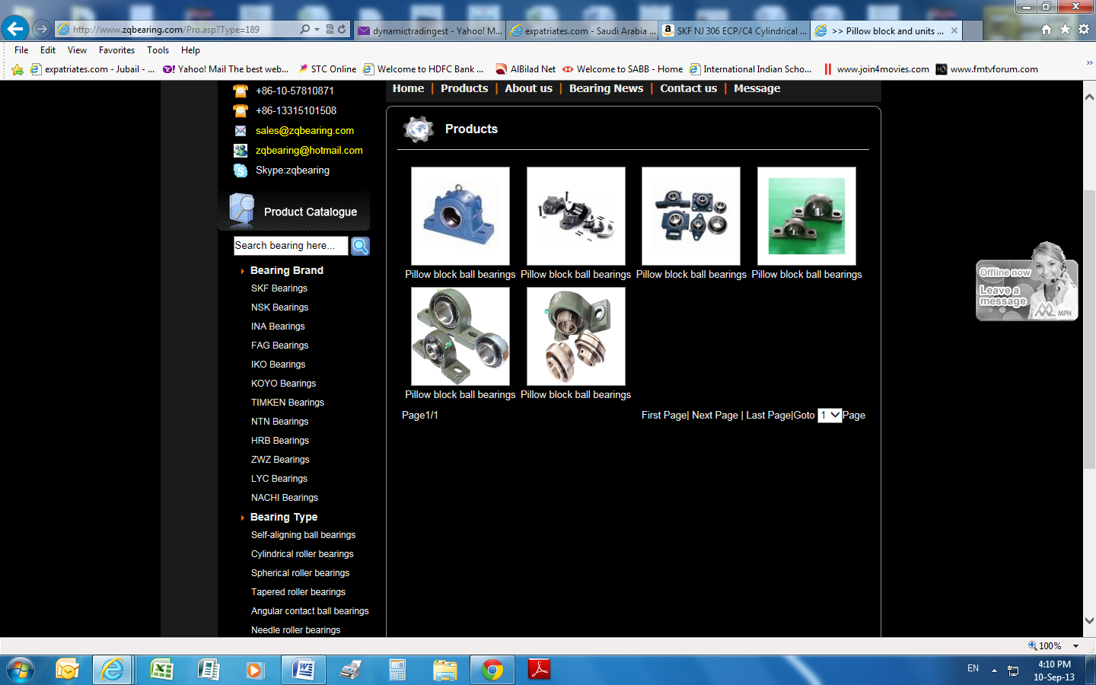
All Types of Bearing

Slide 27
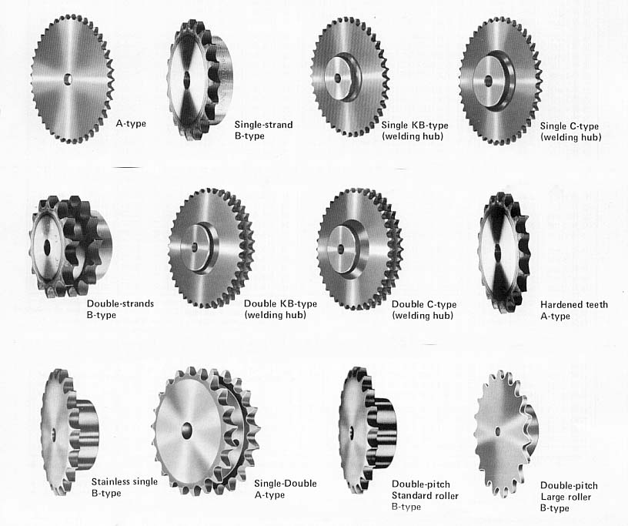
SPROCKETS & PLATEWHEELS

Slide 28
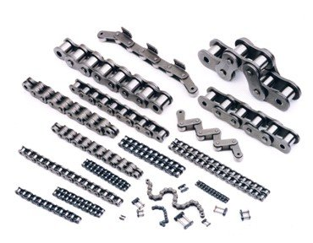
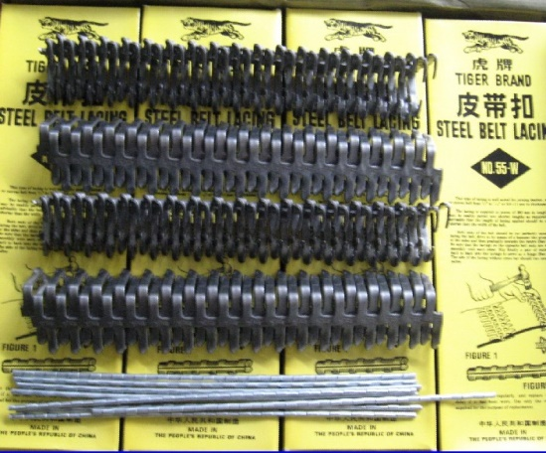
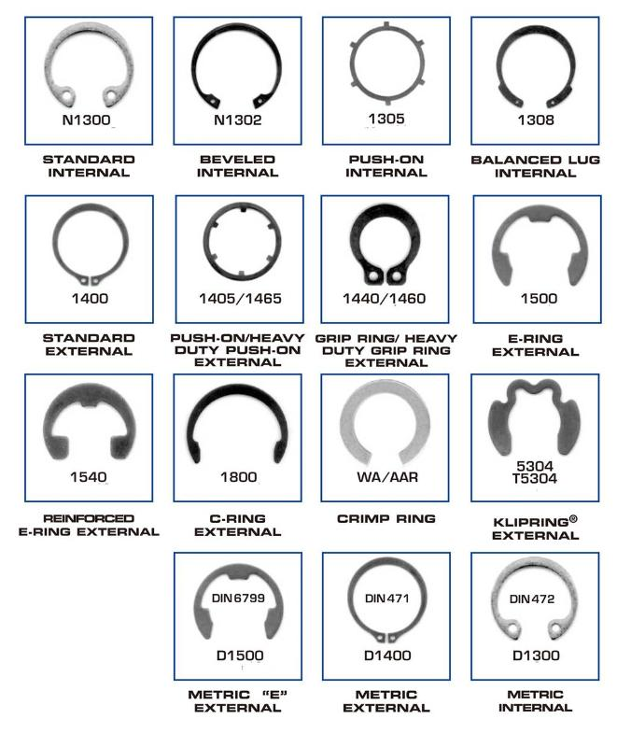
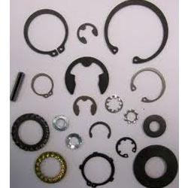
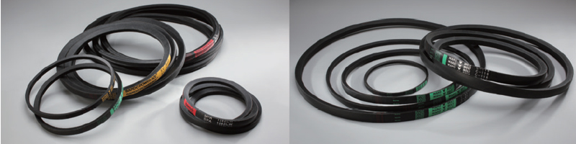
ROLLER CHAINS
BELT LACING
CIRCLIPS
V – BELTS

Slide 29
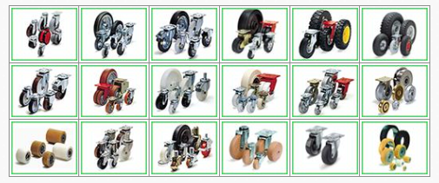
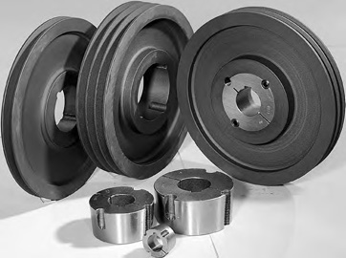


V-BELT PULLEYS & TAPER BUSHES
CASTER WHEELS
CUP BRUSH, WIRE WHEEL BRUSH & PIPE LINE BRUSHES
NAILS / SCREWS / NUTS & BOLTS

Slide 30





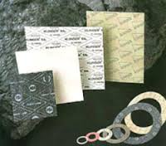
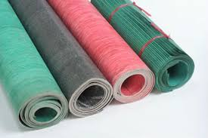










TEFLON BARS & SHEETS
RUBBER SHEETS & RODS
PTFE SHEETS & RODS

Slide 31






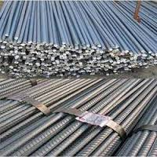

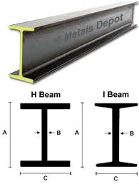
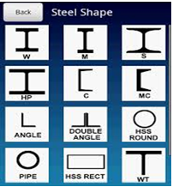

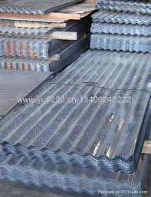
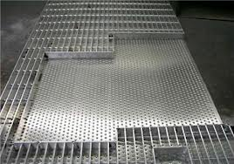

BRASS ROUND & HEX. BARS
COPPER ROUND , FLAT BARS & SHEETS
BRASS SHEETS
CONTRUCTION STEEL
TUBULARS & MS SHEETS
I & H BEAMS
SHINCO SHEETS & ROOFINGS
BLACK & GALV. GRATINGS

Slide 32

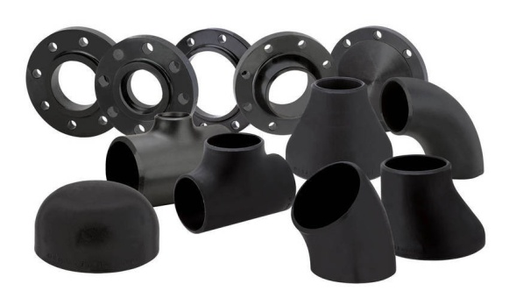
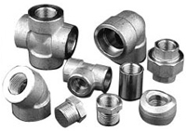
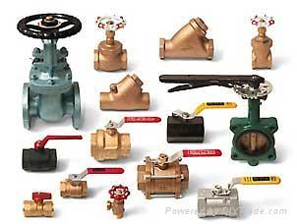

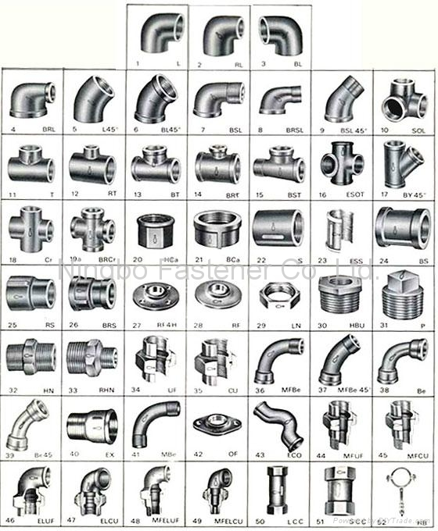
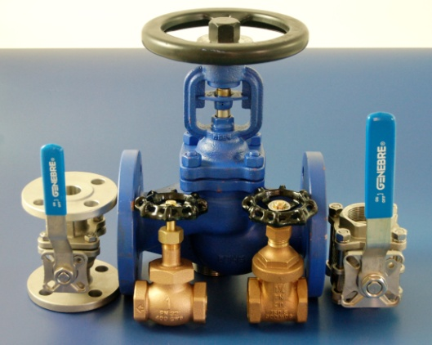

FLANGES, VALVES & FITTINGS

Slide 33
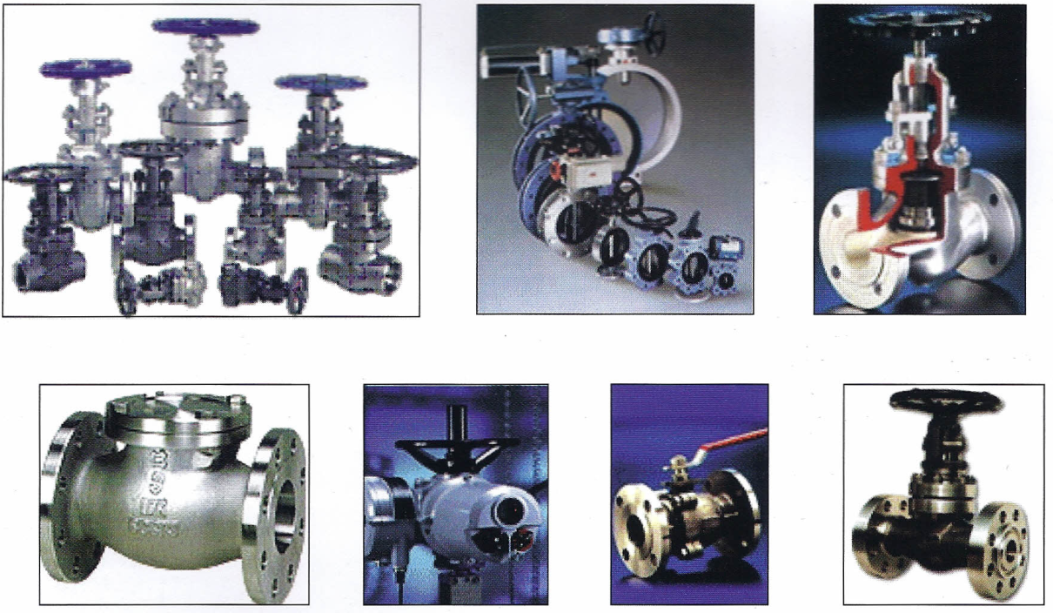
Valves
Material – Carbon Steel, Stainless Steels, Alloy Steel and other Austentic Steel Grades
Material Grade | Ball Valves, Globe Valves, Check Valves, Butterfly Valves, Y-stainers & Plug Valves
Sizes | Size: ¼” to 24”
Origin | Western Europe, Asian

Slide 34
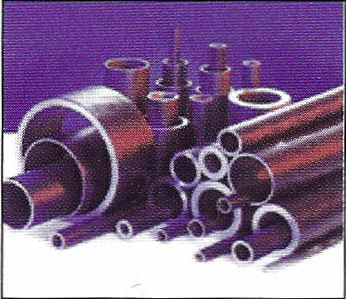
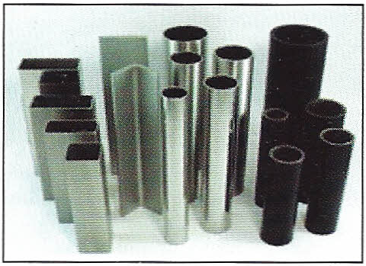
Tubes & Pipes
Material – Carbon Steel, Stainless Steels, Alloy Steel and other Austenic Steel Grades
Material Grade | Type: Seamless, Welded, ERW, EFW, SAW, LSAW
Sizes | ½” to 60” – varying with Material Grades.
Manufacturers Origin | Eastern, Western Europe, Asian & Saudi

Slide 35


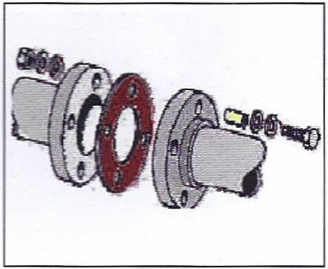
Gaskets & Flanges Insulation Kits
Material – Carbon Steel, Stainless Steel
Material Grade | CS & SS
Types | Spiral Wound, Ring Joint / Gasket type D, E or F for Insulation Kits
Class | 150 thru 900 PSI
Manufacturers | West European, Asian

Slide 36
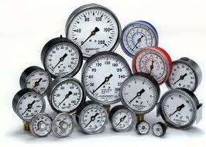
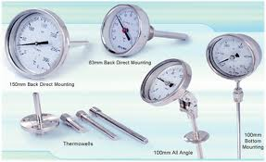
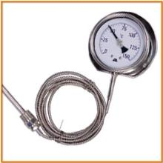
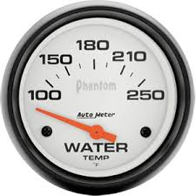










PRESSURE GAUGES, TEMP. THERMOMETERS , FIRE / GAS DETECTORS & MULTIMETERS

Slide 37

All Types of Gratings / Spectacle Blinds / Spades / Spacers

Slide 38

All Types of Instrumentation Fittings

Slide 39

Structural Steel

Slide 40



Slide 41




Slide 42





Heavy Equipments for Rent
All of our supplies equipments are routinely serviced & maintained. Please find below the list of items we supply on short & long term rental basis.
Cranes for Rent

Slide 43

It is the primary goal of BEST SPARE PARTS TRADING EST, to consistently provide our customers with exceptional service, exceed our customer goal and expectations, provide our customers the maximum value and maintain our strong leadership role.
The BEST SPARE PARTS TRADING EST, talented and trained professionals continually focus on safety and quality. The BEST SPARE PARTS TRADING EST, employees’ hard work and dedication ensure our customers that they will always receive flawless service each and every day.
Our continuous focus on safety and quality, combined with our resources, provides our customers at the highest level of safety and excellence.
Value Added Services – BEST SPARE PARTS TRADING EST, also provides the following Value Added Services.
Transportation Services
Heavy Lifts/Heavy Transportation Services
Safety Advantage –BEST SPARE PARTS TRADING EST, take an approach to safety that illustrates the dynamics of loss control. A philosophy of zero accidents helps to form the foundation for a proactive to safety, which encompasses all levels of management from the Managing Director to craft personnel.
The philosophy is simple – zero accidents is the only goal.

Slide 44
BENEFITS DEALING WITH US
Cost Effective
Faster
Safer
Efficient
Reliable

Slide 45
CONTACT INFORMATION
At BEST SPARE PARTS TRADING EST, we are always pleased to build a strong relationship with our suppliers and customers. Our Team will process your request professionally to serve you. Whether you want more information about us, please feel free to contact us on the following contact information:
BEST SPARE PARTS TRADING EST.
P.O.BOX: 1976 AL – JUBAIL 31951
Tel: 013 – 362 5220 Mobile: +966 502412602
E-mail: info@bsp.com.sa / younus@bsp.com.sa / bestspartsest@gmail.com
Saeed Al – Mahroon (General Manager) Tel: 013 – 362 5220 Email: info@bsp.com.sa
Mohammed Younus (Sales Manager) Mobile: 050 241 2602, Email: younus@bsp.com.sa
Mohammed Ali (Business Development Manager) Mobile: 053 640 8626 Email: ali@bsp.com.sa
Kishor Sudhakar Pofali (Sales Engineer) Mobile: 050 130 1383 Email: kishor@bsp.com.sa
Mohammed A. Mubeen Siddiqui (Sales & Marketing Executive) Mobile: 053 739 3247,Email: mubeen@bsp.com.sa
Mohammed Aslam(Showroom In charge) Mobile: 053 042 4783,Email: aslam@bsp.com.sa
Mohammed Shameem(Sales & Marketing Executive) Tel: 050 854 8897, Email: Shameem@bsp.com.sa
Mohammed Abdul Bari (Material Delivery In Charge) Mobile: 00966569213282

